Slide 1


User-friendly interactive WPS programming
Raffaele de Amicis, Giuseppe Conti, Bruno Simões, Stefano Piffer
Fundazione GraphiTech
Notes:
.

Slide 2

Agenda
Motivation
3
Objectives
5
Service Oriented Architecture (SOA)
6
  3D Web Application
7
  Web Catalogue
9
  Web Processing Service
10
  Hot Process Deployment
20
Server Security
29
Conclusions
31

Slide 3
Motivation
The increasing number of people and institutions sharing geographical information
The necessity of move from data to information, to awareness, to knowledge, turning a vast array of data into understandable pieces of intelligence
The problem of interoperability – How to expose processes and handle the requests

Slide 4
Motivation
The problem of visualize large and complex geographic datasets
User-friendly interfaces
  For non-experts GIS users
    Managers
    Scientists
    Decision makers, ...
  To achieve short training time
Fast responses

Slide 5
Objectives
Platform-independent implementation
Scalability
Interoperability
User-friendly interfaces
3D Environment for better data visualization
Support for delayed-time transactions
Possibility to write, deploy and execute processes on-fly

Slide 6
SOA
Service-Oriented Architecture solution consists in 3 main logical components:
  Consumers - composed by entities that makes use of offered services
  SOA infrastructure
    Applications and service support
    Services - composed by entities that performs a specific task when invoked
  Producers - All the entities that offer a specific service or functionality

Slide 7
3D Web Application
The 3D application presents a 3D environment:
  Developed using Java and JOGL
  Built over the World Wind APIs
  Exposed with Java Web Start technology
  Using FOSS libraries such as Geotools, 52º North WPS and JTS

Slide 8
3D Web Application
The application has been engineered with the goal of delivering a web-based 3D and OGC compliant solution
The application is capable to provide interoperable access to geographical information using OGC specifications such as GML, WMS, WFS, WPS and others
Is extremely small

Slide 9
Web Catalogue
Web catalogues are the best way to:
  Organize services
  Speed up time-consuming searches
Furthermore, it should:
  Keep the previous state
  Offer direct access to any sub-level

Slide 10
Web Processing Services
What is a WPS?
  In a few words is Web Based Processing
WPS
Information
Data

Slide 11
Web Processing Services
Example:
WPS
Buffer
Process 2
7
Process n

Slide 12
OGC WPS
WPS
GetCapabilities
Process 1
DescribeProcess
Process 2
Execute
Process n

Slide 13
3D WPS Interface
Drag and Drop
To maximize readability the process icons are rendered as billboards
A process can be composed up to three distinct types of components:
  The process controller itself
  One or more input slots
  One or more output slots

Slide 14
3D WPS Interface
Every process operates as a black box that can receive input and transmit results to a further process via its output slots.
Each input and output slots is automatically created through a process descriptor exposed by the WPS
Since the algorithm processing takes place at the server level, it is executed in an asynchronous way

Slide 15
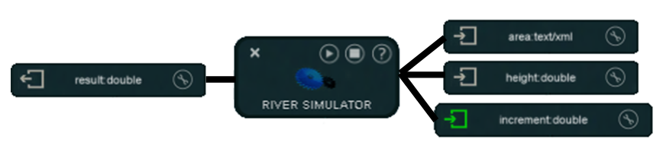
3D WPS Interface

Slide 16
3D WPS Interface
Complex simulations can be created:
  Using processes available through WPS
  Making use of any combination / order (allowing creativity and freedom)
  Using data/results existent in the 3D environment
  In an asynchronous way
  Processed in distributed environments

Slide 17
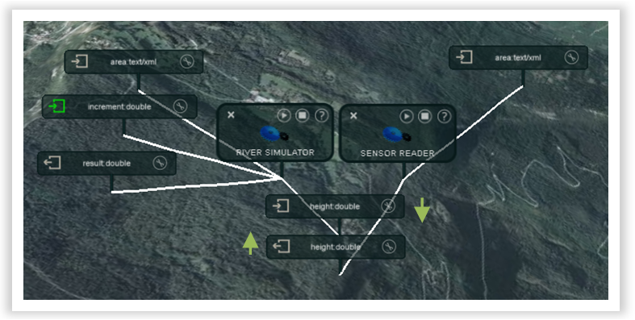
WPS Interface - Connect

Slide 18
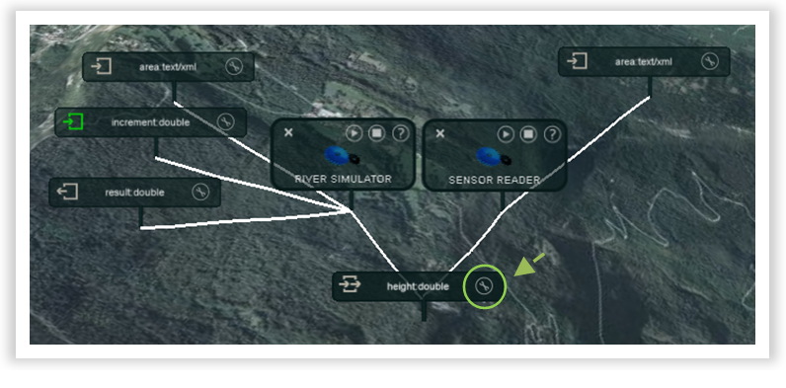
WPS Interface - Disconnect

Slide 19
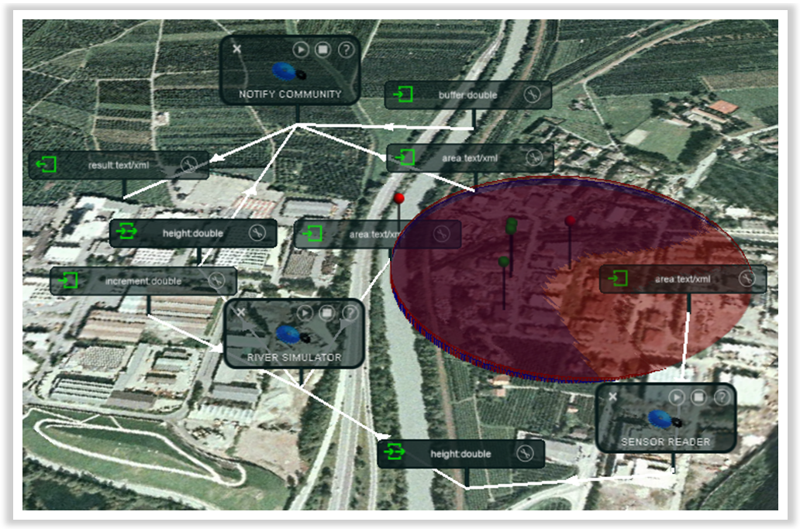
WPS Interface - Example

Slide 20
Runtime Process Deployment
A process can be:
  Created in runtime
    Default values are easily selected from the 3D environment if necessary
  Deployed in runtime
  Executed in runtime
  Write a process is faster and easier

Slide 21
Extended WPS Operations
Three new operations should be available:
  StoreNewAlgorithm
  GetAlgorithm
  RemoveAlgorithm

Slide 22
Store New Algorithms
REQUEST=StoreNewAlgorithm
StoreNewAlgorithm, composed by:
  ProcessDescription – Standard OGC Process Description
  Source – Contains a list of files
    File – Contains the information and content of a file

Slide 23
Store New Algorithms
<?xmlversion=”1.0”?>
<wps:StoreNewAlgorithm version=”1.3.0” service=”WPS”
idgen=”ReplaceWhenDuplicated”
xmlns=”http://www.someserver.com/myns”
xmlns:ows=”http://www.opengeospatial.net/ows”
xmlns:wps=”http://www.opengis.net/wps”
xmlns:xsi=”http://www.w3.org/2001/XMLSchema-instance”
xsi:schemaLocation=”http://www.someserver.com/myns
http://www.opengis.net/wps ../wps/1.3.0/WPS.xsd”>
<ProcessDescription processVersion=”2”
storeSupported=”true”
statusSupported=”false”>
...
</ProcessDescription>
<Source>
<File name=”TestAlgorithm.Java”
language=”Java” main=”true”>
R0lGODlhZABq...base64...
</File>
<File name=”sample.bin”>
R0lGODlhZABq...base64...
</File>
<Source>
</wps:StoreNewAlgorithm>

Slide 24
Request GetAlgorithm
  HTTP://www.someserver.com/path/wps?
  SERVICE=WPS&
  VERSION=1.3.0&
  REQUEST=GetAlgorithm&
  IDENTIFIER=<Process Name>&
  FORMAT=XML

Slide 25
Request RemoveAlgorithm
  HTTP://www.someserver.com/path/wps?
  SERVICE=WPS&
  VERSION=1.3.0&
  REQUEST=RemoveAlgorithm&
  IDENTIFIER=<Process ID>

Slide 26
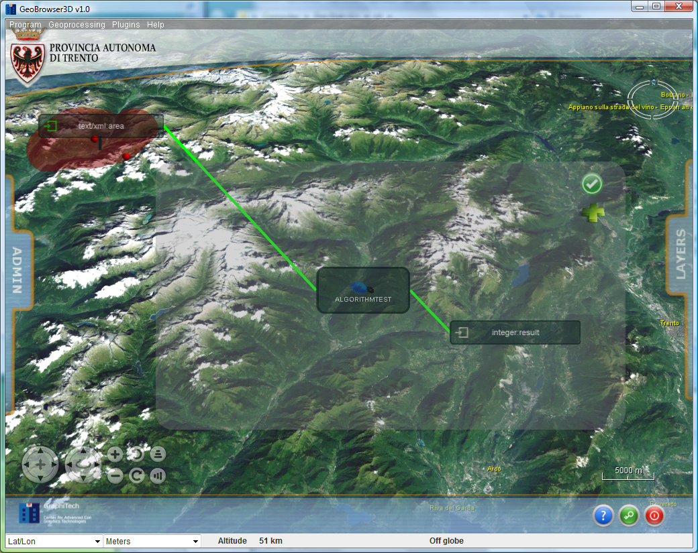
Runtime Process Deployment

Slide 27
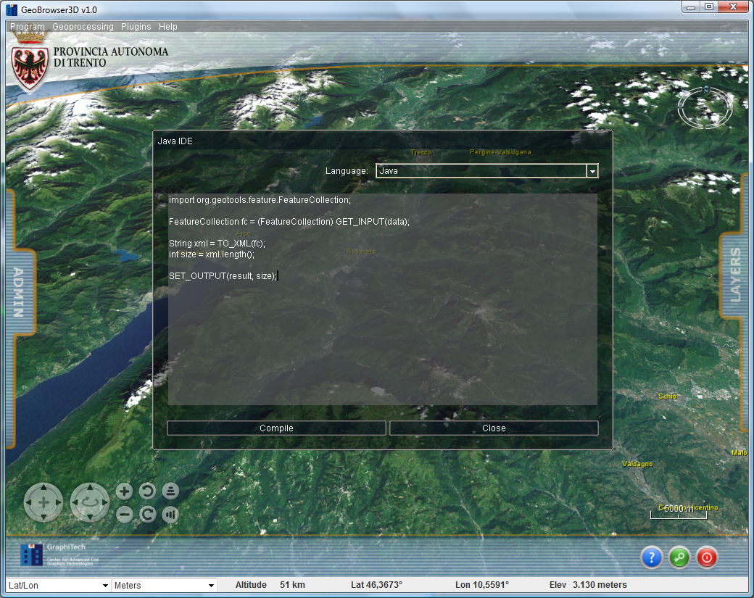
Runtime Interpreter/Compiler

Slide 28
Runtime Interpreter/Compiler
import org.geotools.feature.FeatureCollection;
FeatureCollection fc = (FeatureCollection) GET_INPUT(data);
String xml = TO_XML(fc);
int size = xml.length();
SET_OUTPUT(result, size);

Slide 29
Server Security
Security risk categories:
  System modification
  Invasion of Privacy
  Denial of Service
Java presents a multitier approach:
  Denial of Service
  Restricted access to file systems and to browser internals
  Load time & runtime checks to verify that byte code is following the rules
  A system for signing code and assigning it some level of capability

Slide 30
Server Security
The Java Security Manager works as follows:
  A Java program makes a call to a potentially dangerous operation.
  The Java API code asks the Security Manager if the operation is allowed.
  The Security Manager throws a SecurityException if the operation is denied. This exception propagates back to the Java program.
    Support user and code permissions

Slide 31
Conclusions
Today interoperability is starting to become a reality thanks to several international harmonization efforts
Security risk is very low as possibilities of exploiting holes is limited
Various Java engines coexisting on a machine could share a common security configuration
The user can see the results in 3D environments

Slide 32
Conclusions
Experiments showed that users have clearly indicated that this interface in general can be:
  Considered suitable and self descriptive for the given task
  Allow any decision maker that is not GIS expert to make use of it, with virtually no training

Slide 33


THE END
Thank you for your attention
Questions
Contacts:
{raffaele.de.amicis, giuseppe.cont, bruno.simoes, stefano.piffer} @ graphitech.it

Slide 34


EXIBITION VIDEO

