Slide 1

Two-dimensional dam break flooding simulation: a GIS embedded approach.
Massimiliano Cannata and Roberto Marzocchi
IST-SUPSI, Institute of Earth Sciences

Slide 2
Risk assessment
GISs are invaluable in risk assessment due to their capability in solving the location issue
  Where happens?
  What are the extension?
  Who and what is there?
  WHILE
Models solve equations to simulate the phenomena (area and intensity of events)

Slide 3
GIS-Model integration
GIS
MODEL
GIS
MODEL
CONVERSION
Independent
Loosely coupled
INTERFACE
GIS
MODEL
GIS
MODEL
GIS
MODEL
Tightly coupled
Embedded

Slide 4
Why another model?
To take into account the location, models implement their own “spatial” functions and libraries, but these already exist within GISs at an highly specialized level (as a result of decades of development)
CURRENTLY
GISs lack of extensive environmental modelling capabilities and therefore risk assessment studies imply the usage of different software, systems and environments
SO
We decided to Improve GIS simulation capability developing
GIS EMBEDDED MODELS

Slide 5
Open or Proprietary software?
Software cost = $0
Source code is available and modifiable
User and development communities
flourish
Development cycles are VERY fast
Platform support (i.e. UNIX, Linux, Windows, Mac OS)
Speed and efficiency
Numerous data format support
Standards for interoperability (OGC
specs)
Total cost is NOT = $0
Many applications are not as
polished as the proprietary
counterparts
Compatibility with proprietary software and formats can be an issue
Separate packages require multiple
installation and maintenance
Documentation is sometime poor
Linkage with Proprietary software (can be hard)
User Interfaces are often the last
development

Slide 6

Open or Proprietary software?
Software cost = $0
Source code is available and modifiable
User and development communities flourish
Development cycles are VERY fast
Platform support (i.e. UNIX, Linux, Windows, Mac OS)
Speed and efficiency
Numerous data format support
Standards for interoperability (OGC specs)
Total cost is NOT = $0
Many applications are not as polished as the proprietary counterparts
Compatibility with proprietary software and formats can be an issue
Separate packages require multiple installation and maintainance
Documentation is sometime poor
Linkage with Proprietary software (can be hard)
User Interfaces are often the last development
SMOTH INTERFACES
C source code
GRASS GIS
is
a mature solution
EXCELLENT FORMATS SUPPORT
ROBUST LIBRARY
NATIVE PAKAGES
GOOD DOCUMENTATION

Slide 7
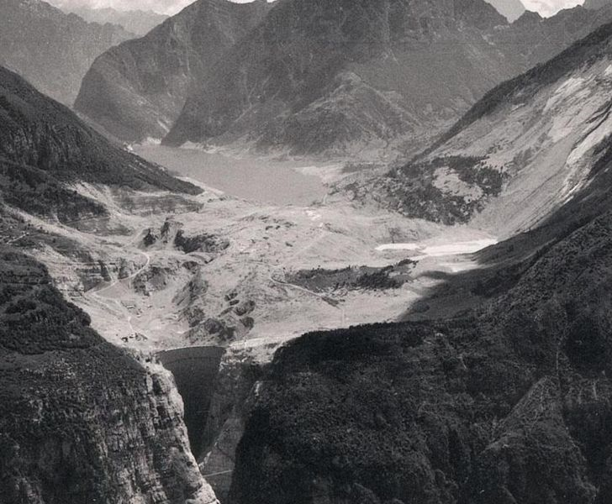
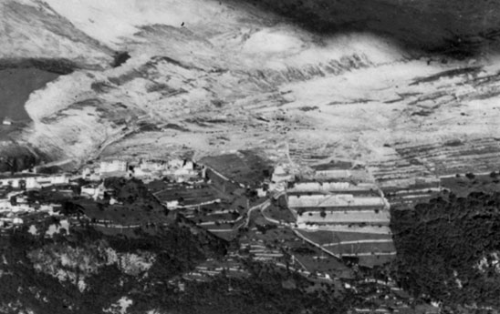
Flash floods due to dam failure
Vajont, 9 October 1963
Most of the dams were built in the 40s – 70s
In many countries maintenance founds are poor
High development in downstream valleys in the last decades
Need for updated risk assessment and emergency plans

Slide 8
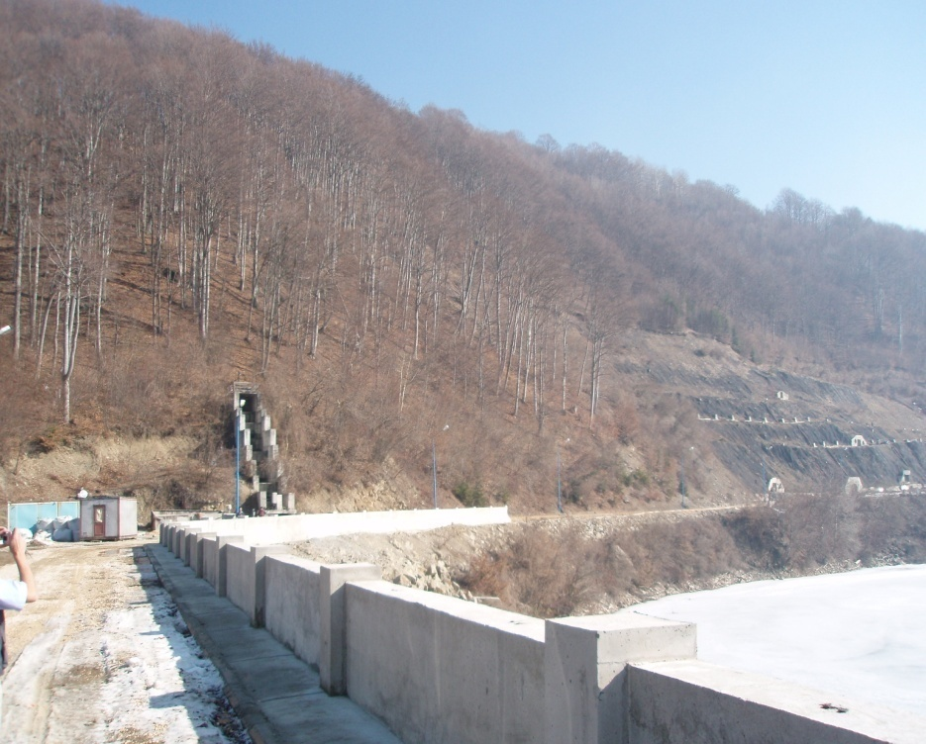
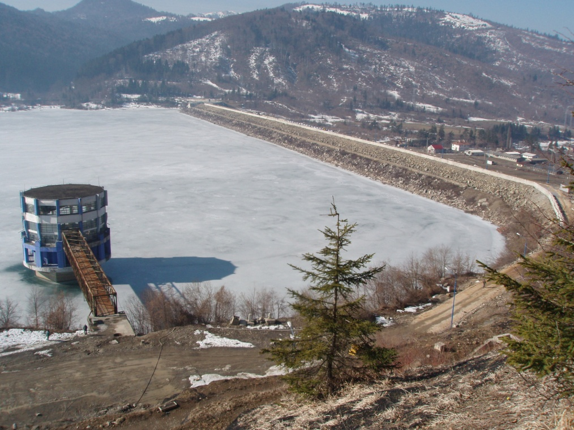
Example of dam failure risk
Romania, Sacele Dam:
Landslide threatening water outlet tower and likely generating impact wave causing overtopping and consequent dam erosion and failure

Slide 9
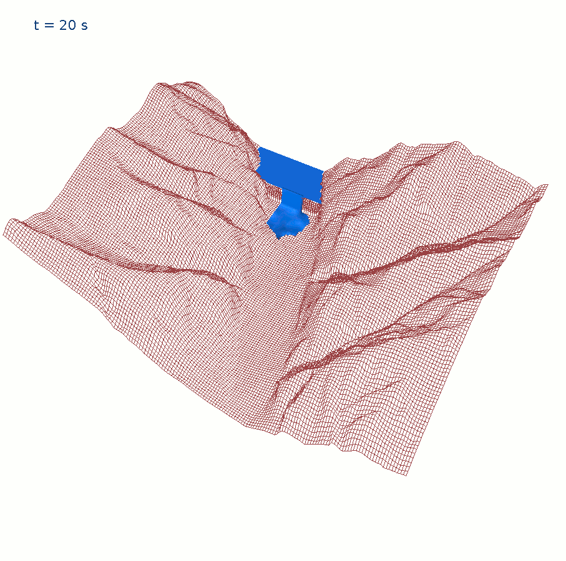
Approach: problem formulation
Mathematical model that solves the conservative form of the
2D Shallow Water Equations (SWE)
using a
Finite Volume Method (FVM) and
produce maximum intensity maps
that can be directly used for risk assessment and emergency plans development.

Slide 10
Shallow Water Equations: assumptions
Good approximation to fluid motion equations when fluid density is homogenous and depth is small in comparison to characteristic horizontal distances:
component of velocities along the vertical direction is negligible if compared to the horizontal ones
the pressure distribution over the flow depth is nearly hydrostatic
Free surface
  The 3D Navier – Stokes governing fluid dynamic equations are integrated on the depth and conduct to a 2D formulation of the problem
h
Vh
Vz

Slide 11
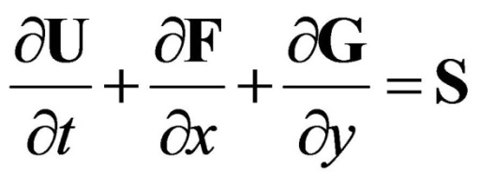
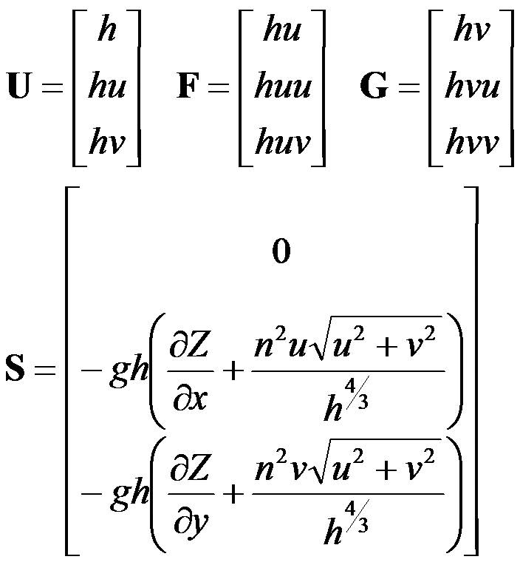
Shallow Water Equations: formulation
U = vector of conserved variables
F = x-direction flux vector
G = y-direction flux vector
S = source vector
h = water depth [m],
u = x-direction flow velocity [m/s],
v = y-directions flow velocity [m/s],
g = gravitational acceleration [m/s²],
Z = water level expressed in orthometric height [m a.s.l.]
n = Manning’s roughness coefficient [s/m^{1/3}]

Slide 12
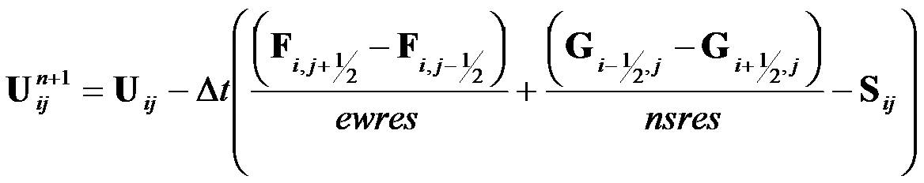
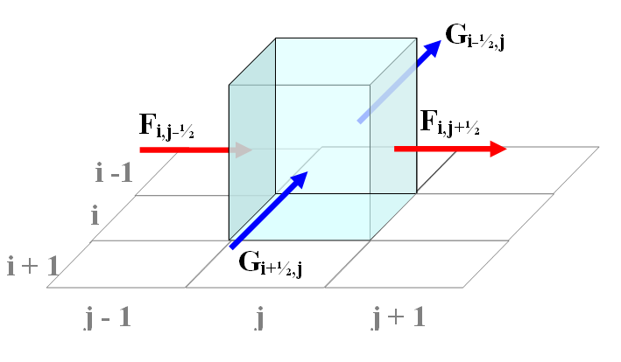
Shallow Water Equations: solution
applying the Upwind Conservative Scheme by Ying et al. [2004] we get the solution
With the one-sided upwind method we solves explicitly this equation in two separate steps:
the continuity equation is evaluated deriving the water depth at time t+1,
these values are used to solve the momentum equations that provide the flow velocities at time t+1

Slide 13
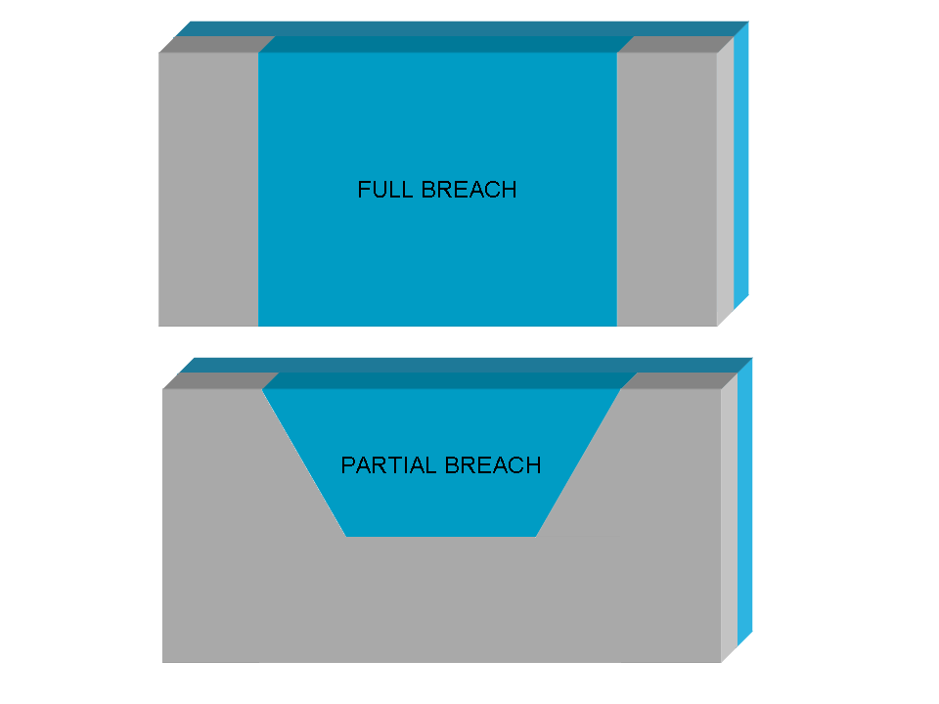
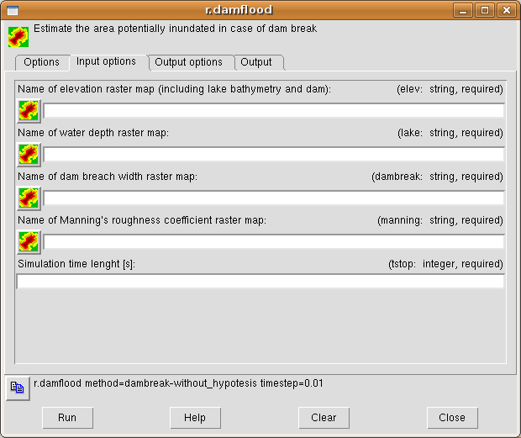
r.damflood
Input options
  elevation raster map
  (accounting for reservoir's bathymetry and dam elevation);
  lake water depth raster map
  (easily obtained with r.lake GRASS GIS module);
  dam breach width raster map
  (decreased dam height due to failure);
  manning’s roughness coefficient raster map;
  simulation time length.
  simulation timestep
Output options
  time-lag for outputs generation;
  additional instants for output map generation;
  prefix for water depth output tseries raster maps;
  prefix for water velocity output tseries raster maps;
  maximum water depth and relative time output raster map;
  maximum water velocity and relative time output raster map;
  maximum intensity output and relative time raster map.
Intensity = max(h,v·h) [>2,2-0.5,<0.5]
(time series raster maps are coded as prefix + _ + elapsed seconds: e.g. mydepth_125)

Slide 14
Model verification (synthetic case 1)
2D Partial instantaneous dam-break: to evaluate the capability in modeling different severe hydrodynamic difficulties
upstream water depth h_{u} =10 m
downstream water depth h_{d} = 0 m
timestep = 0.01 s
t = 6 s
upstream water depth h_{u} =10 m
downstream water depth h_{d} = 0.1 m
timestep = 0.01 s
t = 6 s
upstream water depth h_{u} =10 m
downstream water depth h_{d} = 5 m
timestep = 0.01 s
t = 6 s

Slide 15
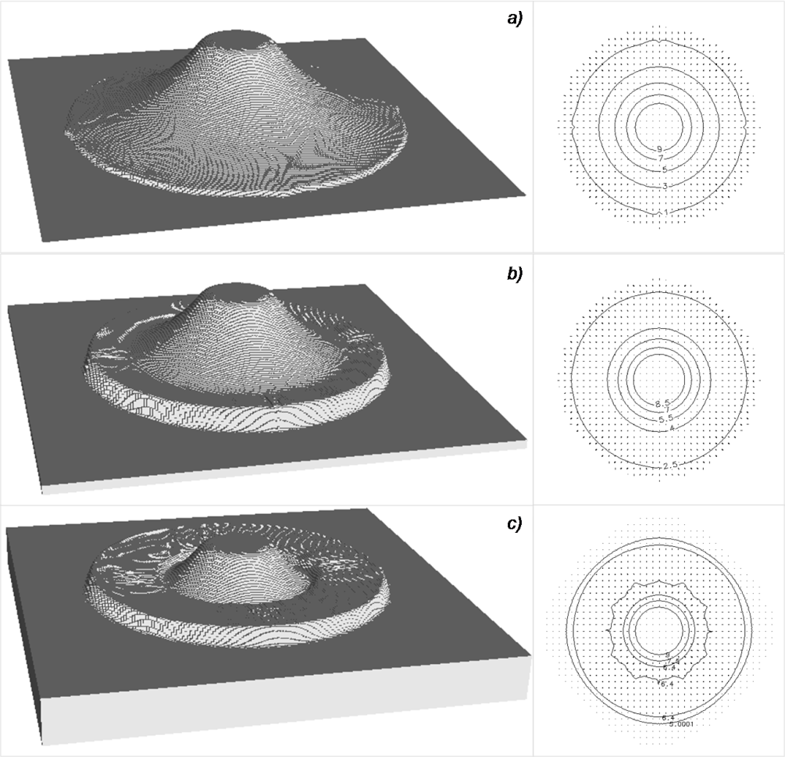
Model verification (synthetic case 2)
2D breaking of a circular dam in a rectangular domain: to evaluate the capability in modeling symmetric dam-break flow
upstream water depth h_{u} =10 m
downstream water depth h_{d} = 0 m
timestep = 0.005 s
t = 0.69 s
upstream water depth h_{u} =10 m
downstream water depth h_{d} = 1 m
timestep = 0.005 s
t = 0.69 s
upstream water depth h_{u} =10 m
downstream water depth h_{d} = 5 m
timestep = 0.005 s
t = 0.69 s

Slide 16
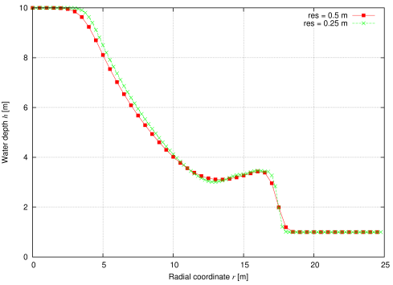
Model verification (synthetic case 2)
Model behavior at two different grid resolution
Notes:
- Sembra essere “indipendente” dalla risoluzione a patto di garantire la stabilità numerica

Slide 17
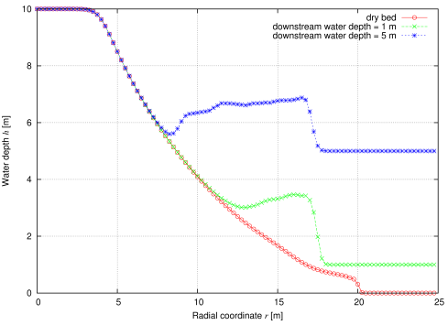
Model verification (synthetic case 2)
Small perturbations in axis direction
Notes:
- Onda per acqua a valle non nulla come da esempi letteratura
- Coordinate cartesiane e non cilindriche danno perturbazioni piccole non importanti

Slide 18
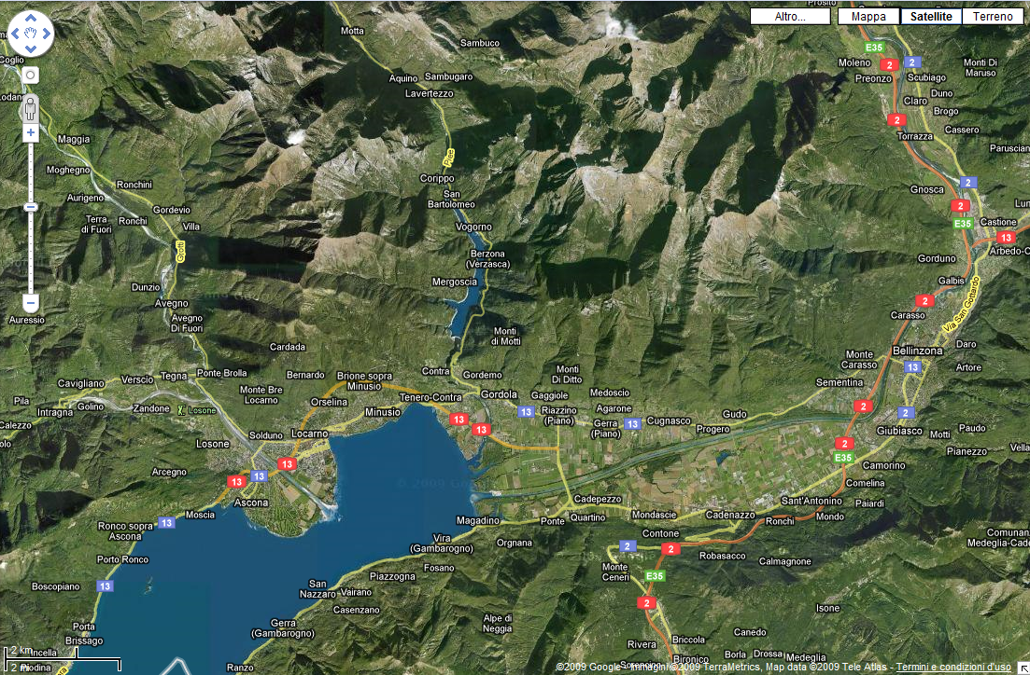
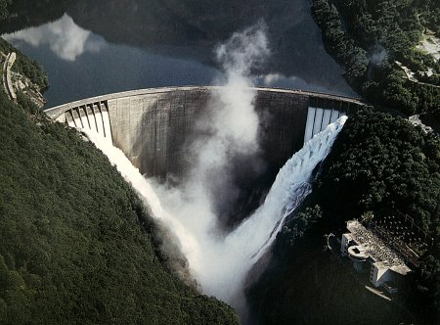
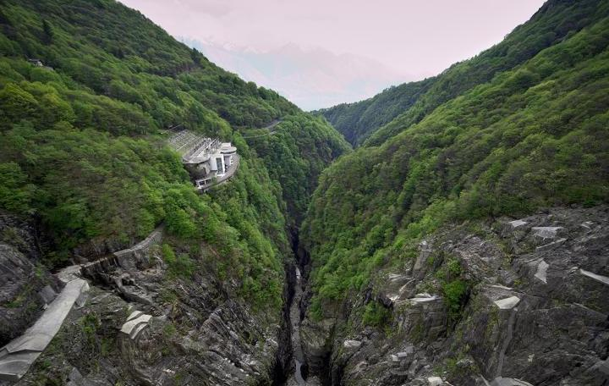
Model validation
Application to an existing Swiss dam: Verzasca
The dam, that is one of the highest dam in the world (220 m), forms the Vogorno Lake, a wide artificial reservoir with a maximum water level of 469 m a.s.l., a volume of 105 Mio mP^{3P}, a surface of 1,68 Mio mP^{2P} and a length of 5.5 km [http://www.swissdams.chUTH].

Slide 19
Model validation: simulation run
computational domain:
  E-W size: 20,025 m
  N-S size: 20,000 m
  Resolution: 25 m
  Total cells number: 640,000
simulation timestep: 0.01 s
simulation length: 3600 s
computational running time: 16 h 39’ 53’’
(on a 1.7 GiB memory, 2 Intel® Core™ 2 Duo CPU E 4500 computer)

Slide 20
Model validation: water depth
Maximum
water depth
map (h[m])

Slide 21
Model validation: water velocity
Maximum
water
velocity
map
(V [m/s])

Slide 22
Model validation: intensity
Maximum
intensity
map
(F [m²/s])

Slide 23
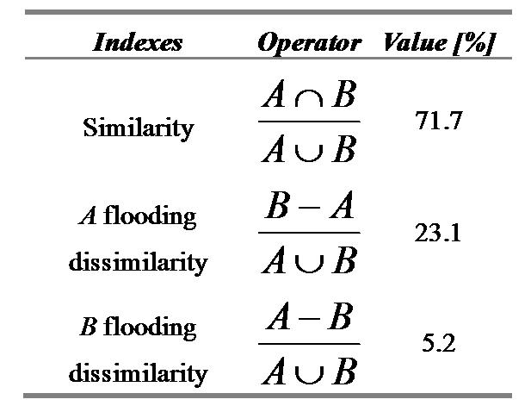
Model validation: flood extension
hazard zone covered by simulation
residual hazard zone covered by simulation
residual hazard zone not covered by simulation
simulation on no hazard zone

Slide 24
Model validation: timing
15 s 30 s 45 s
Comparison between existent front wave vector map and obtained raster map

Slide 25
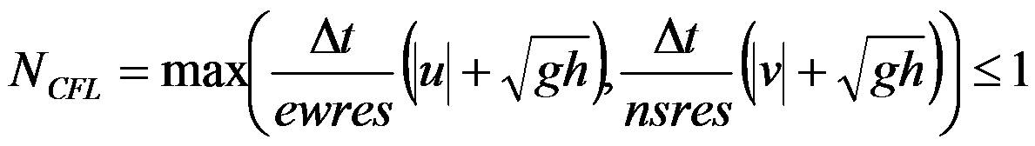
Future works
Adaptive timestep length:
like other explicit numerical schemes, the stability of proposed solution is driven by the Courant-Friedrichs-Lewy condition:
practically there is a relationship between grid resolution, velocities, water depth and timestep: at equal resolution for higher velocities smaller timestep are required.
We will develop an dynamic adaptive procedure setting timestep length to guarantee stability and minimize computational times.
Overtopping:
the model currently account for total or partial dam break, we are considering to extend the model to account for overtopping events too.
Comparison with other models:
compare simulation results, input requirements and computational times

Slide 26
Conclusions
We have developed a GIS embedded module for dam break modeling that is suitable for risk assessment.
We have validated this model proving the correctness of the simulation qualitatively and quantitatively
We have shown how environmental models can be efficiently integrated in FOSS4G

Slide 27
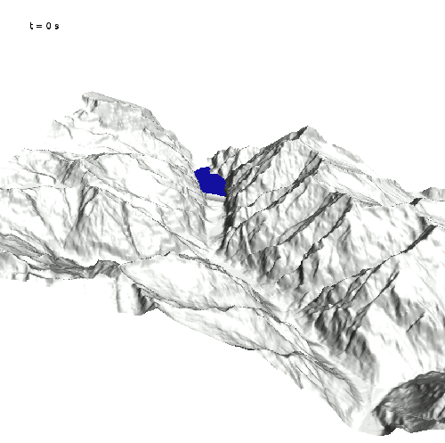
Thank you for your attention
Visit
http://istgeo.ist.supsi.ch/site/projects/dambreak
for more information

