Slide 1


gvSIG Sensors
SWE
Services
Javi Carrasco
Miguel Montesinos
Carlos Sánchez
Fran Peñarrubia
Alain Tamayo

Slide 2

What is gvSIG?
Desktop GIS/SDI client (WMS, WFS(-T), WCS, CSW,…)
Open-source (GPL)
Funded by Regional Gov. of Valencia & U.E.
Vector & Raster Support
Integrated with Sextante (200+ geoprocessing functions)
Translated into 20+ languages
Mailing lists: 3000+ users
75.000 downloads
http://www.gvsig.org
http://www.gvsig.gva.es

Slide 3
What is gvSIG Mobile?
Mobile GIS/SDI client (WMS, WFS(-T), WCS, CSW,…)
Open-source (GPL)
Funded by Regional Gov. of Valencia & U.E.
Vector (GML, SHP, KML,…) & Raster (ECW, JPEG, …) Support
GPS support
Editing capabilities
http://www.gvsig.org
http://www.gvsig.gva.es

Slide 4


Who are we?
Spanish company
16 years GIS experience
70 + employees
Member of gvSIG Project Steering Committee
High focus on FOSS4G
Members of gvSIG Association
Members of Sextante Geospatial Services
www.prodevelop.es

Slide 5
What are we presenting?
Prototype of SOS client on gvSIG Desktop
Prototype of SOS client on gvSIG Mobile

Slide 6


Who has made it?

Slide 7
Sensor Observation Service
Part of OGC SWE (Sensor Web Enablement) family
OGC Specification (1.0.0)
Access to sensor description and its observations
WFS SOS Protocol
GML O&M Data
- SensorML Metadata
Notes:
Protocol: SOS similar to WFS (get measurements)
Data: O&M (Observations & Measurements) comprise GML (for location) + O&M + SWE Common (common SWE data schemas like units of measurements, …)
Metadata: Sensor ML describes sensor (its location, Id, phenomenon it measures –temperature, pressure,…-, procedure of data processing, etc.)

Slide 8

Sensor Observation Service
GetCapabilities
SOS Capabilities Document
DescribeSensor
SensorML
GetObservation
Select Data (proprietary)
Selected Data (proprietary)
O&M Data
Notes:
SensorML is extracted from local repositories (filesystem,…) in a non-standard way
Observation Data is extracted from local Database or other non-standard ways.
Sensor data go from physical sensors to a DB by whatever way the server has implemented it. In 52th North there are 3 ways:
A process reads sensor data (usually from local ASCII/binary files received from sensors) and format the information and stores it in a DB structure (DB tables).
A ETL (Extraction and Transformation Language) runs periodically and stores info in the DB tables
Modify source code, by extending DAO classes so that they look up for info in a different repository (tables, files, …)

Slide 9
What’s been implemented?
SOS Core Operations Profile
  GetCapabilities
  DescribeSensor
  GetObservation
Notes:
These are the mandatory SOS operations

Slide 10
What has not been implemented?
SOS Transaction Operations Profile
  RegisterSensor
  InsertObservation
SOS Enhanced Operations Profile
  GetResult
  GetFeaturesOfInterest
  Etc.
Notes:
Transaction Profile suited for auto-registering of sensors -> I’m a sensor and want to register into a SOS service to publish my observations (RegisterSensor). Later I send observations to the server (InsertObservations)
Enhanced Profile is for additional operations (GetResult: Receives periodically data without asking GetObservation one and again, GetFeatureOfInterest: Get FeatruesOfInterest published by a server in a BBOX , GetFeatureOfInterestTime: Idem + time filter, DescribeFeatureOfInterest, DescribeObservationType: returns an XML schema of an Observation Type, DescribeResultMode:returns the schema for the result element that will be returned when the client asks for the given result model)

Slide 11
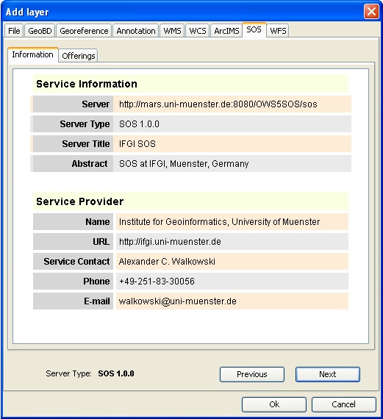
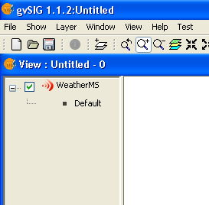
gvSIG Desktop SOS client
SOS offering as a new layer

Slide 12
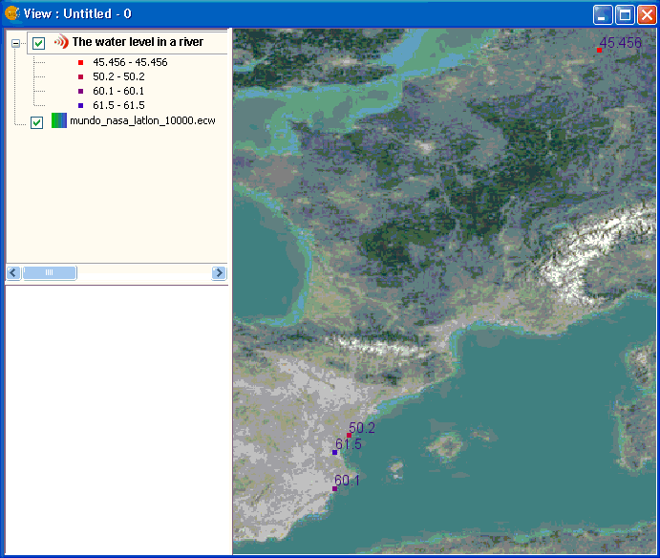
gvSIG Desktop SOS client
Procedures (sensors) location

Slide 13
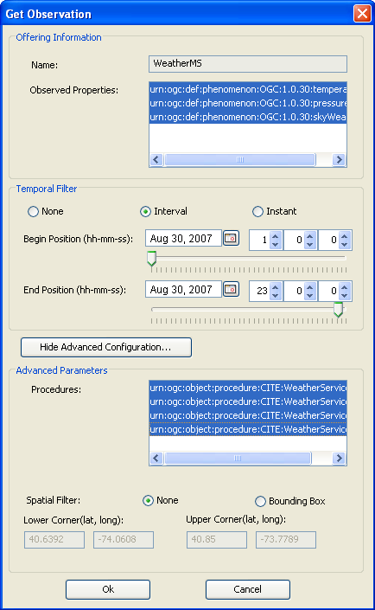
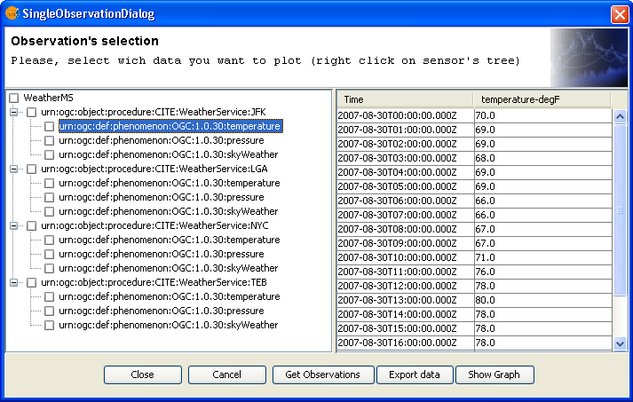
gvSIG Desktop SOS client
Get Observations

Slide 14
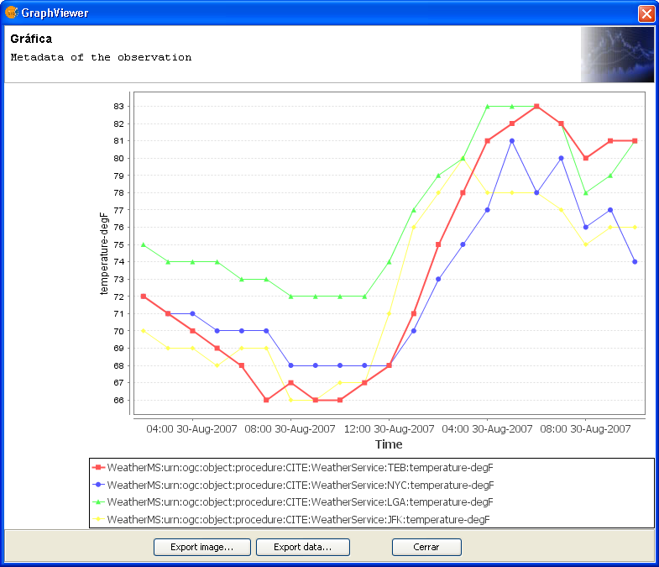
gvSIG Desktop SOS client
Graphics support

Slide 15
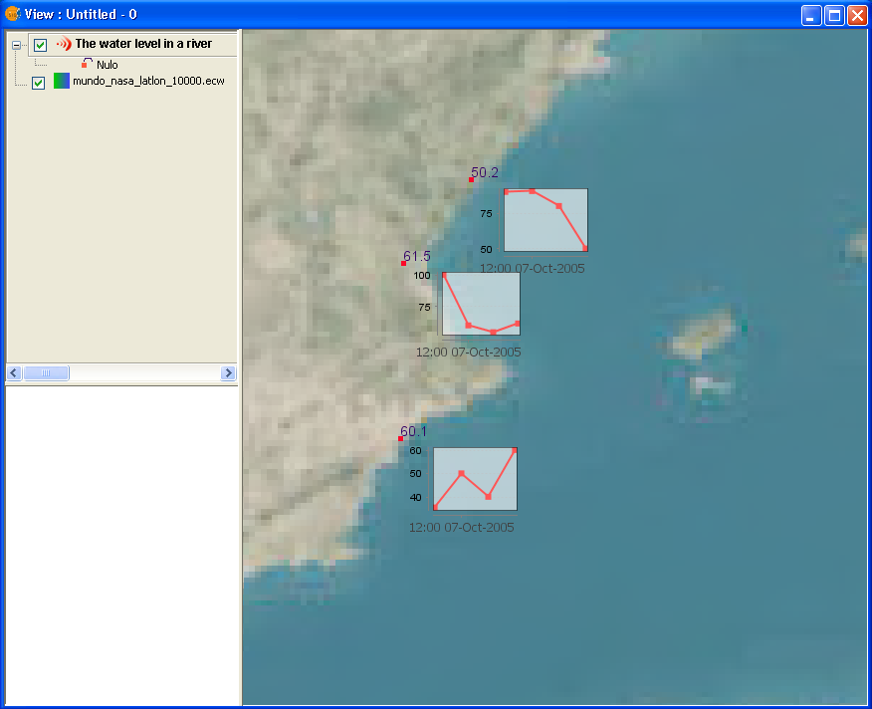
gvSIG Desktop SOS client
Graph Symbology

Slide 16
gvSIG Desktop Video

Slide 17
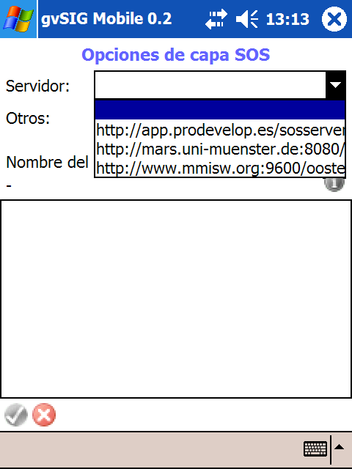
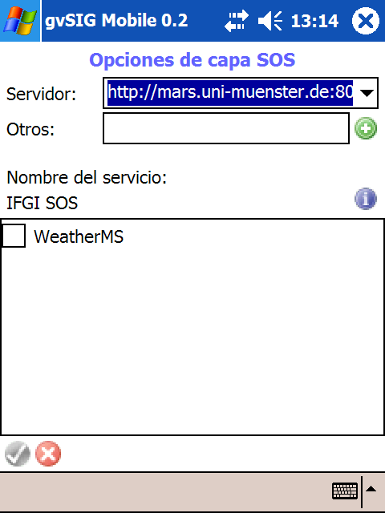
gvSIG Mobile SOS client
SOS offering as a new layer

Slide 18
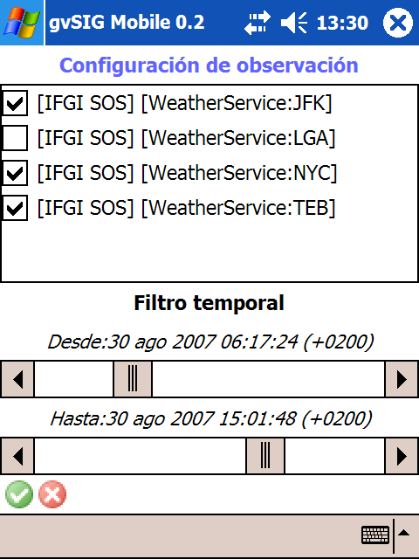
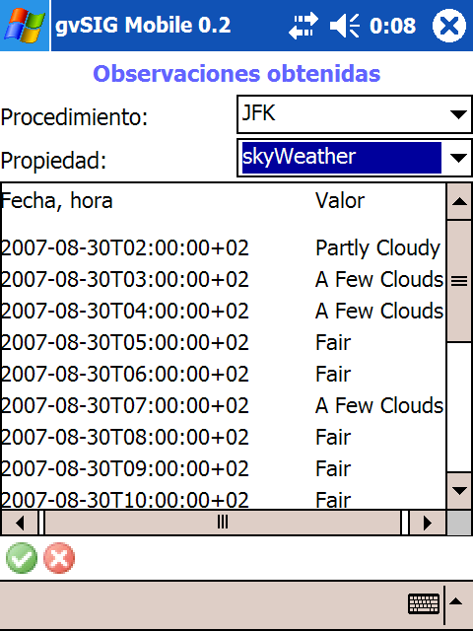
gvSIG Mobile SOS client
Get Observations

Slide 19
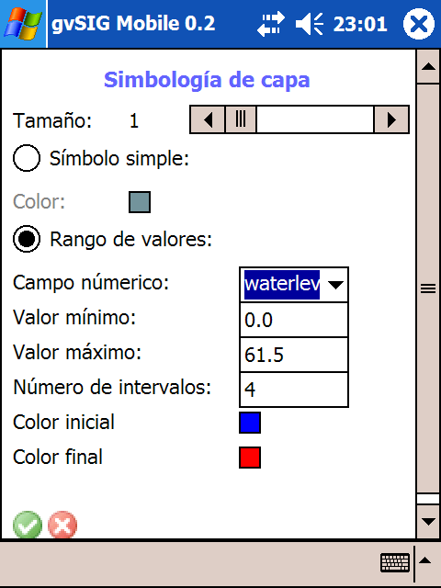
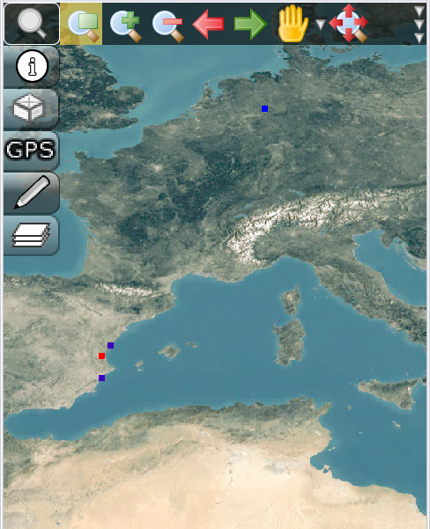
gvSIG Mobile SOS client
Thematic representation

Slide 20
gvSIG Mobile Video

Slide 21
What’s next ?
gvSIG Desktop
  Integration into gvSIG 2.0 official version
  Integration with discovery services
  Transactional Profile Support
  Real-time dynamic sensor data on map
  Integration with layouts
Collaborations are wellcome

Slide 22
What’s next ?
gvSIG Mobile
  Integration into gvSIG Mobile 1.0 official version
  Transactional Profile Support?
Collaborations are wellcome

Slide 23
¿?

Slide 24



Thank You jcarrasco@prodevelop.es

