Slide 1


gvSIG Mini
OSM
for almost every phone
Javi Carrasco
Alberto Romeu
Miguel Montesinos

Slide 2
What is it?
Map Viewer with GPS functions
For mobile phones
Free and Libre (GPL)
Not an official gvSIG project
Intended for non professionals
Uses online services

Slide 3
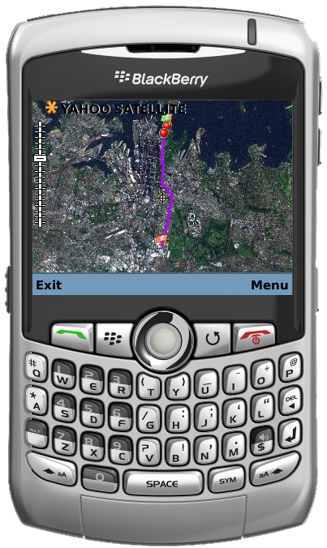
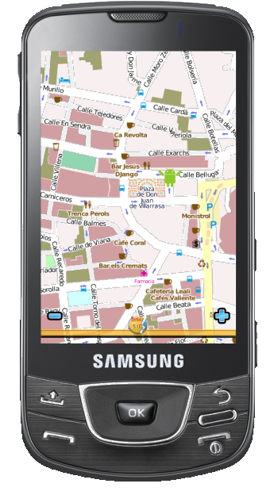
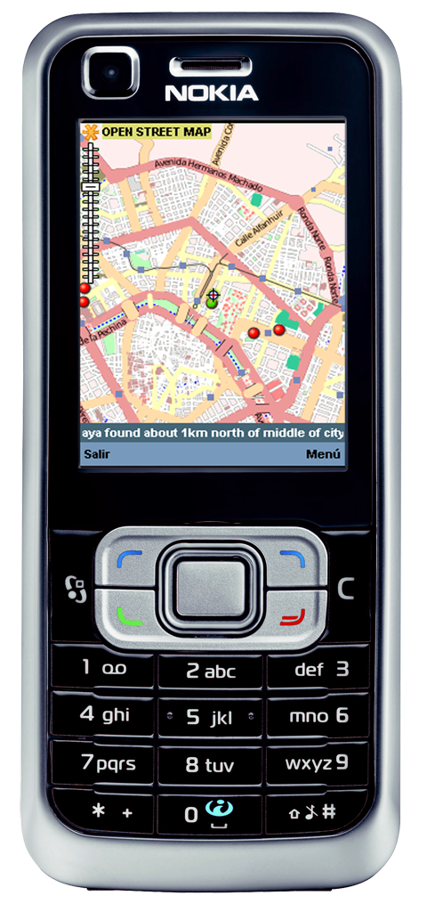

What does it look like?

Slide 4
Who is doing it?
Spanish company
16 years GIS experience
70 + employees
Member of gvSIG Project Steering Committee
High focus on FOSS4G: Victoria, Cape Town, Sydney
Members of gvSIG Association
Members of Sextante Geospatial Services

Slide 5
What are its features?

Slide 6
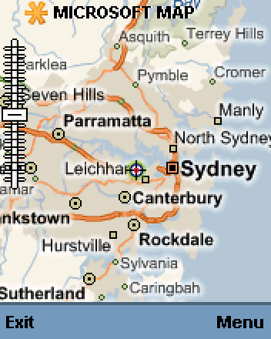
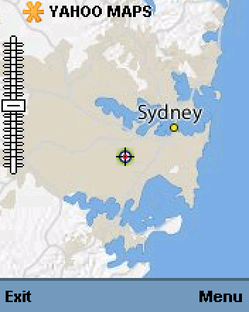
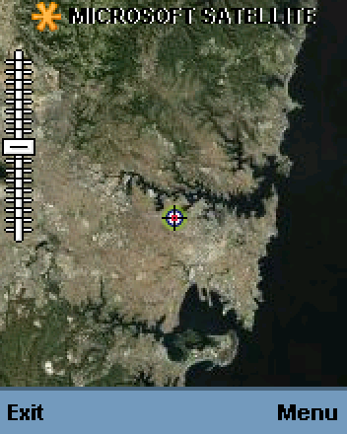
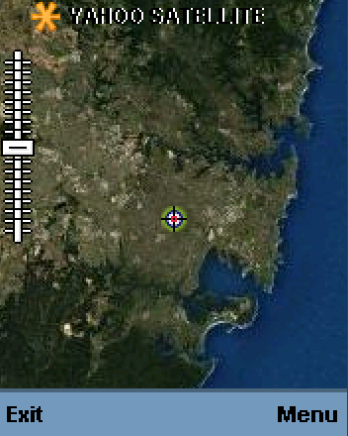
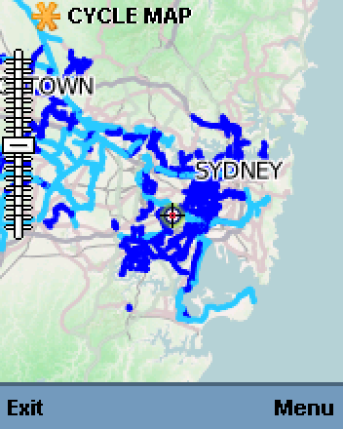
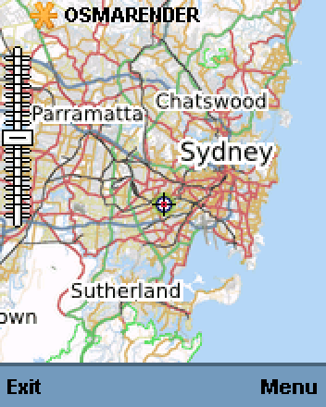
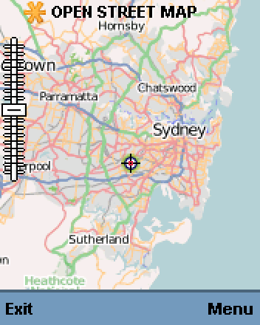
Map viewer
Notes:
Tiled, zoom and pan, keyboard based
WMS and WMSC

Slide 7
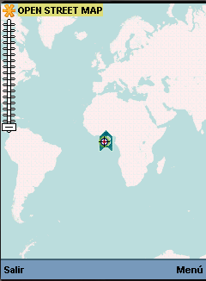
GPS Positioning
See my location
Search close POIs
Use position for routes

Slide 8
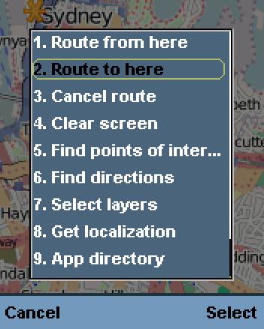
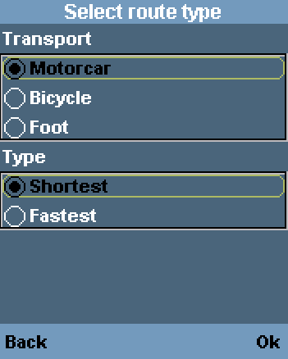
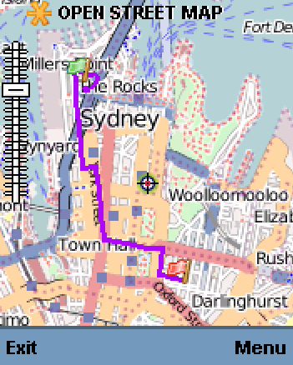
Route finder (YOURS)

Slide 9
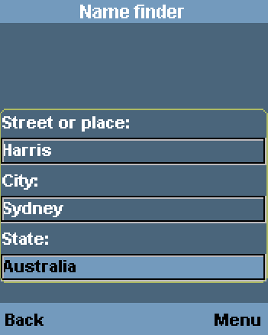
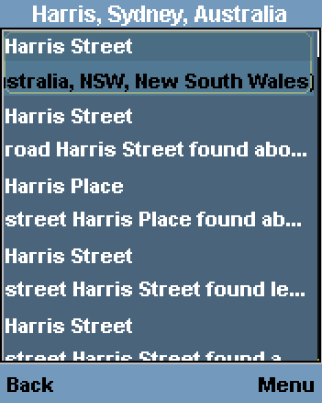
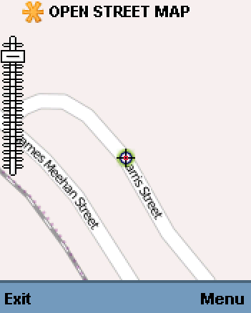
Address search (Name Finder)

Slide 10
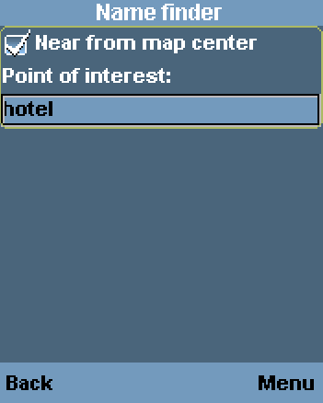
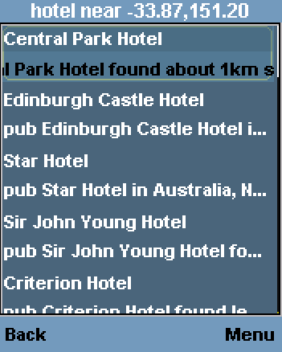
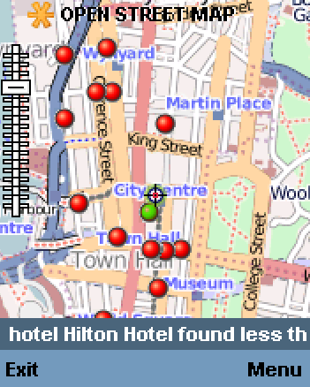
POI Search (Name Finder)

Slide 11
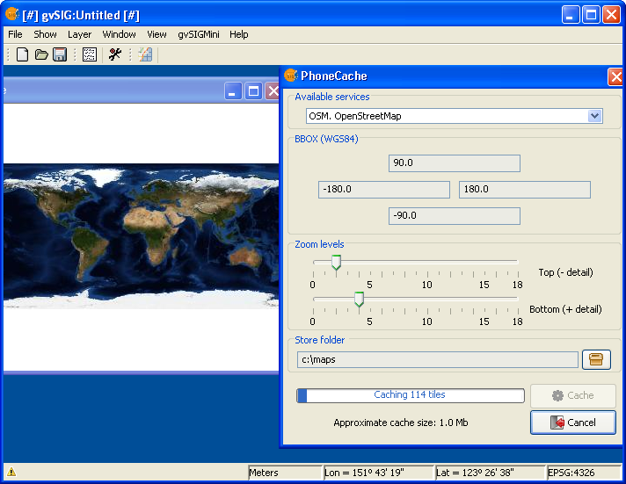
Phone Cache (Tiles downloader)

Slide 12
What are the Requirements?
Standard phones
  Java CLDC 1.1/MIDP 2.0 enabled phone
  (Optional) GPS and JSR 179
  (Optional) Network connectivity
  (Optional) JSR 75: Filesystem access
Android
  (Optional)Network connectivity
  (Optional) GPS

Slide 13
How is it being done?
Tiles + vector routes + POIs
LWUIT for enhaced user experience
Multithread
Persistent cache
Based in OSM services
Supported SRS: "EPSG:4*" "EPSG:230*" "EPSG:326*" "EPSG:327*" "EPSG:275*" "EPSG:27700"

Slide 14
Where to get it?
From PC
  gvsigmini.org
From phone
    m.gvsigmini.org

Slide 15
What’s next?
Personal POIs storage
Tracklogs and waypoints storage
Disconnected address search
Integration with social applications
Unify Android and CLDC code
Collaborations are wellcome

Slide 16
Video

Slide 17
¿?

Slide 18



Thank You jcarrasco@prodevelop.es

